Slide 1
StudentTranscripts Service Overview
September 2017

Slide 2
Overview
New online application for current and former students to:
Access secondary school transcripts, certificates, scholarship information, and course and examination marks
Order and electronically send transcripts to post-secondary institutions
Replaces two existing applications:
Student Secure Web (SSW) – portal with limited function for current students to access course and exam information and request transcripts be sent to post-secondary institutions
Transcripts and Certificates Online (TACO) – public site for former graduates to order copies of their transcripts and graduation certificates.

Slide 3
Benefits for Students
View assessment and exam marks
View transcript
View scholarships and awards
Download digital, pdf or hardcopy of official transcripts
Select up to 25 Post-Secondary Institute (PSI) selections for free
Request real time transfer of transcripts to PSI and employers
Authorize ongoing PSI access to receive transcript updates throughout the year
Receive real time feedback on status of transcript delivery
Benefit from PSIs’ early admission and program acceptance decisions

Slide 4
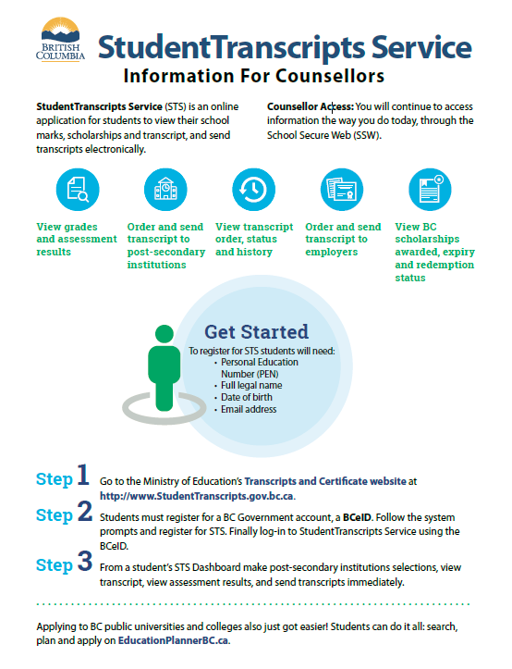
Communications
Poster for School Counsellors

Slide 5
Getting Started
Important Information for Students
Students must register for a BC Government account, a BCeID before accessing the StudentTranscript Service.
Current students receive 25 free transcripts for distribution
Students are responsible for ensuring transcript accuracy prior to transmission to post-secondary institutions
Notes:
Additional transcripts cost $10 per transcript
Students must contact their home school if there are any discrepancies in their transcript.

Slide 6
Getting Started: BCeID Sign Up
From the Transcripts and Certificates web page, select Sign up for a BCeID.
Notes:
BCeID is an online service that makes it possible for you to use one user ID and password to sign in securely to many Government services in British Columbia.

Slide 7
Getting Started: BCeID Sign Up
Complete the Fields to register for a BCeID

Slide 8
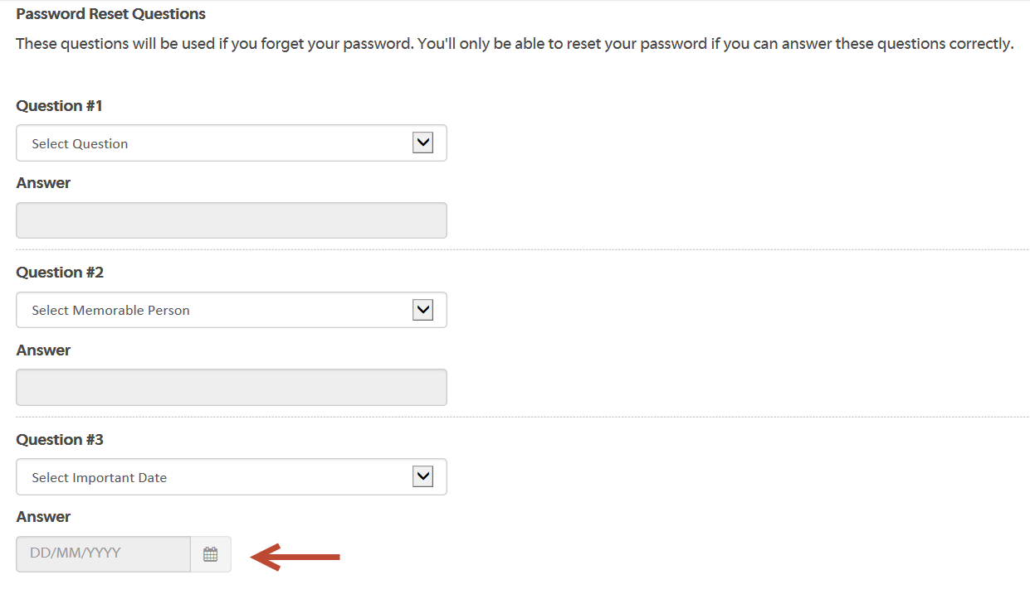
Getting Started: BCeID Sign Up
Select Password Reset Questions and Answers
Tip: Select the calendar tool to enter in important date

Slide 9
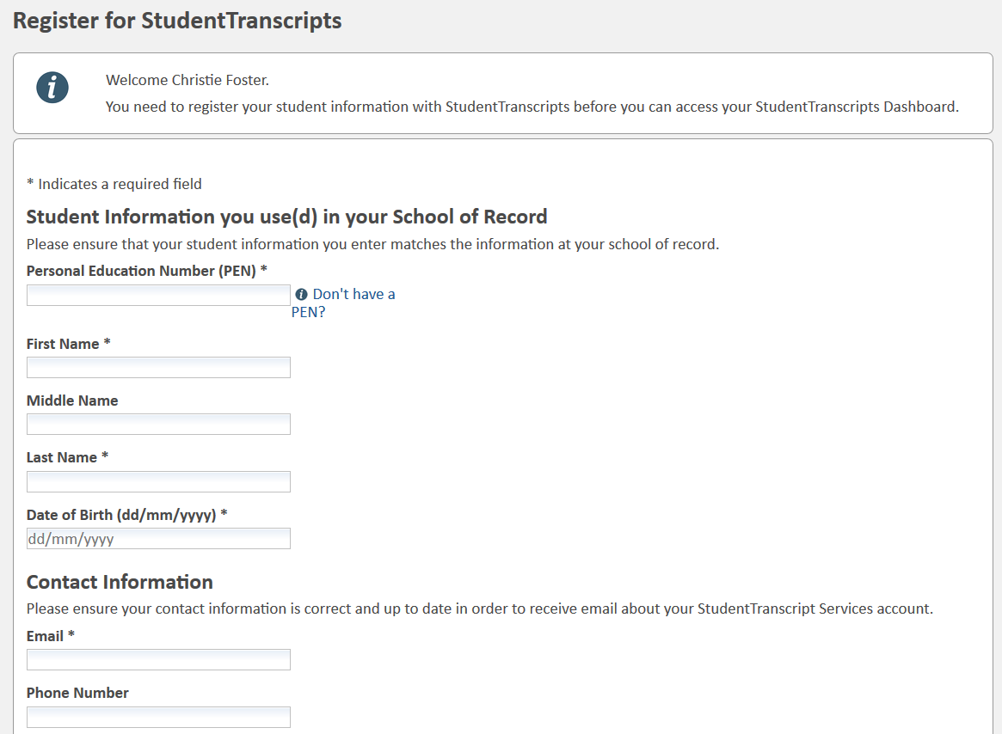
Register for StudentTranscripts
Register for the StudentTranscripts Service
Tip: PEN, First Name, Last Name and email are mandatory fields
Notes:
Students must provide their PEN, legal name and birthdate to obtain access to their records.

Slide 10
Authorize Data Collection
Read the Data Collection to complete the process.

Slide 11
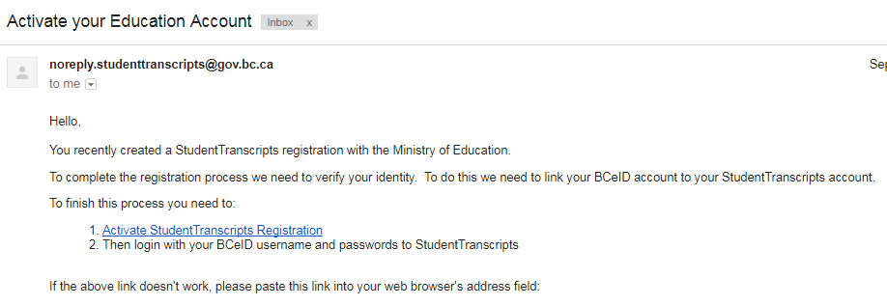
Email Verification
An email confirmation will be sent to activate registration.
Click on link to link the newly created BCeID to the students STS account.
Notes:
The system will display a registration confirmation message advising an email has been sent; to activate the registration and link a BCeID to a student’s STS Account you need to click a link in the email.
After you click the link the system will prompt you to enter your BCeID user name and password to finalize the process.

Slide 12
Logon with the BCeID
Read the Data Collection to complete the process.

Slide 13
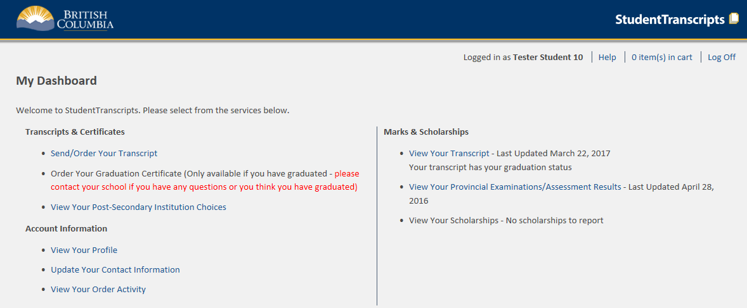
Student Dashboard
Main Student Dashboard following authentication and authorization
Notes:
The Student Dashboard provides access to the functions available to students once they have:
1. authenticated using either a Basic BCeID or BC Services card, and
2. successfully been authorized to access their transcript records.

Slide 14
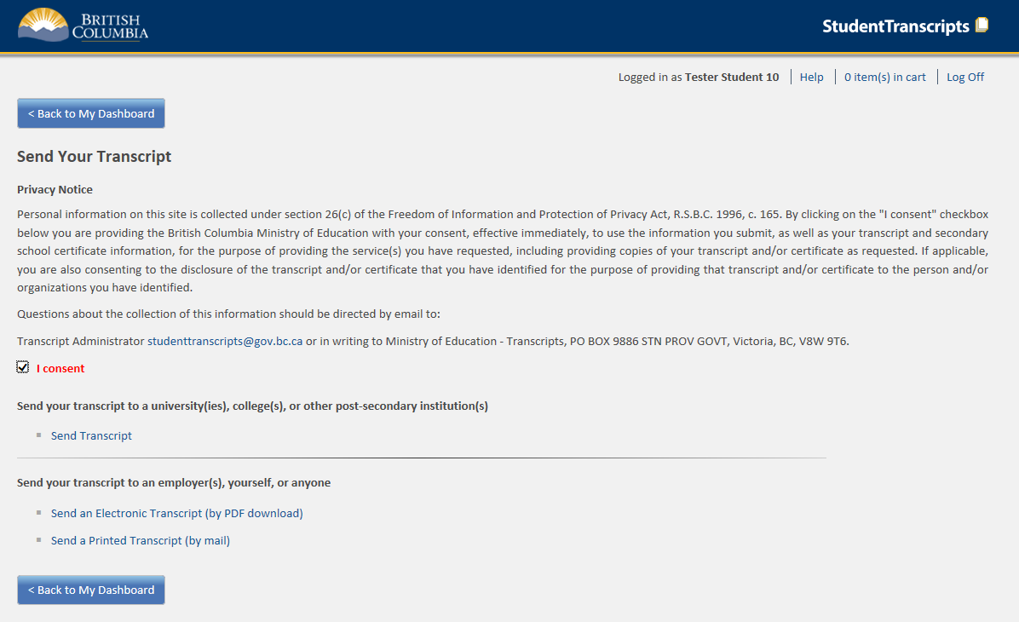
Send/Order your Transcript
Privacy consent activates links below
Send Transcript to PSI
Send PDF Transcript or Send Printed Transcript
Notes:
Privacy consent box (once checked) enables the other links for:
Sending transcripts to PSIs; or,
Sending transcripts to other third parties.
Electronic Transcript (by PDF download) will operate much like an electronic bank transfer transaction requiring the email address of the receiver and a shared security question and answer.
Printed Transcripts will now also be automated through direct PDF transcript printing at BCMail for subsequent mailing to the specified destination.

Slide 15
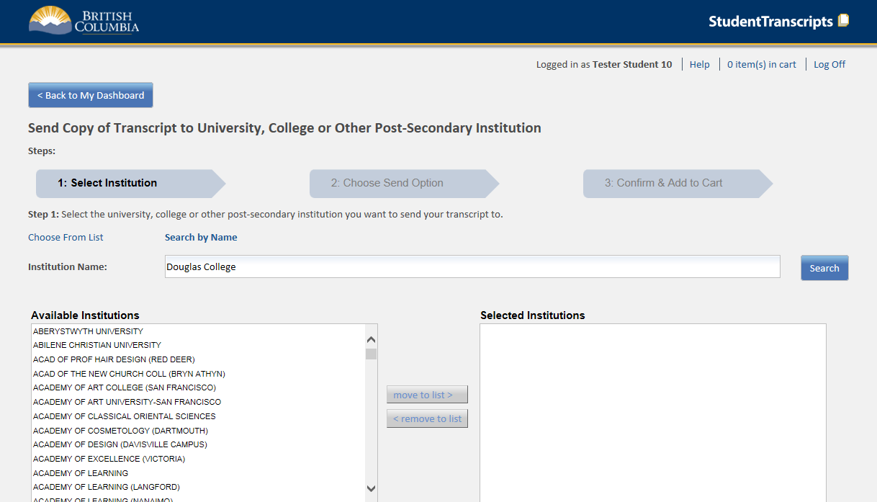
Step 1 – Search for PSI
Select one or more institutions
Notes:
After selecting Send Transcript to PSI
Step 1 is to select the institutions to receive the transcript. Multiple institutions may be selected or removed from the selected institutions box.

Slide 16
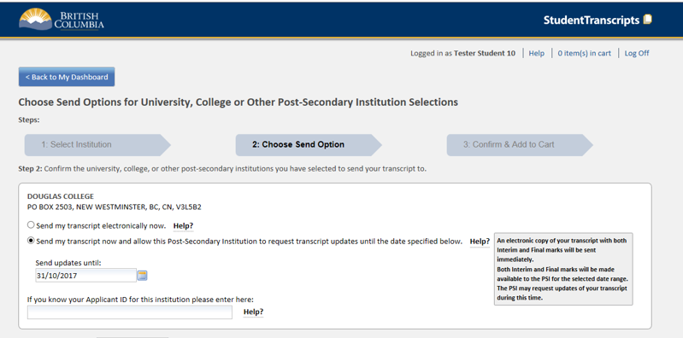
Step 2 – Choose send option
Options available for an institutions that receive printed transcripts
Options available for an institutions that receive the TRAX electronic batch file
Notes:
Step 2 will display these options for PSIs that receive transcripts via printed transcript or via a batch electronic file in May (for interim marks) and July (for final marks) If multiple institutions were selected, multiple boxes (one for each institution) will be displayed with their appropriate send options.
The send options available will vary depending if the institution receives paper, batch electronic, or xml transcripts.
The send options will also vary for Current or Former students.
Post-Secondary Institutions that receive printed transcripts will display these options:
Send my printed transcript now – Sends a one-time printed transcript by mail based on currently completed courses (no interim marks or current courses are displayed)
Send Final Marks when they become available – Sends a final transcript by mail after all final marks are recorded in July.
Post-Secondary Institutions that receive batch electronic files will display these options:
Send my printed transcript now - Sends a one-time printed transcript by mail based on currently completed courses (no interim marks or current courses are displayed)
Send Interim and Final marks when they become available – Sends an electronic file of transcript interim marks in May and also sends an electronic file of final marks in July.

Slide 17
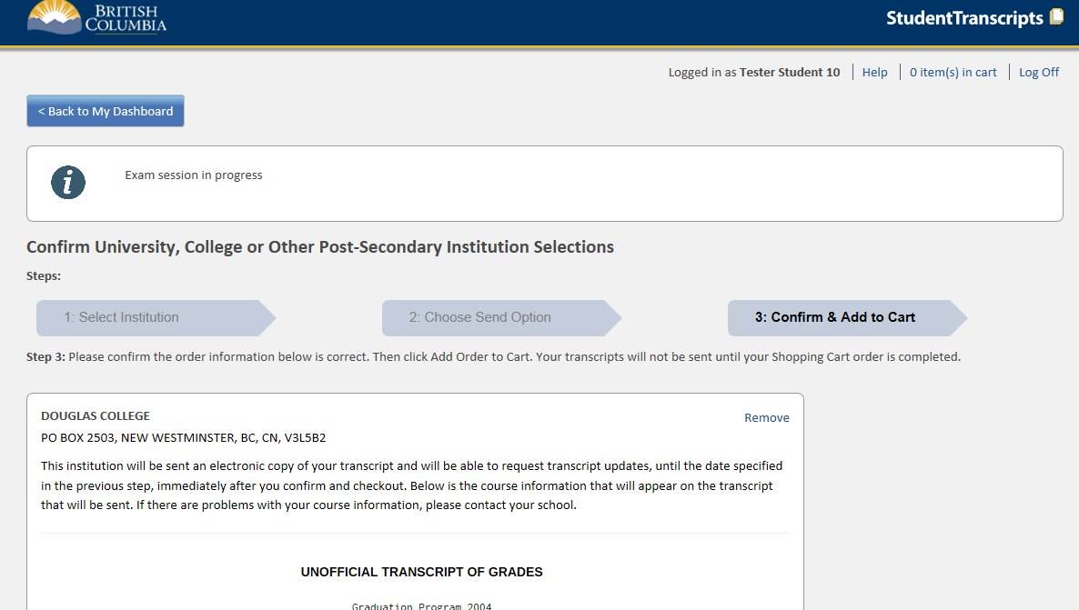
Step 3 – Confirm and add to cart
Informational message area to warn students of any exam marks that may not yet be complete
Preview of Transcript prior to sending
Notes:
Step 3 provides the student with the opportunity to view their current transcript prior to sending to ensure that it is accurate.
It is important that students review this carefully to ensure that all current courses and courses taken at other schools are included. If any information is incorrect or incomplete, students should contact their home school and cancel the transcript order until they can confirm that the information is correct.
An informational message (controlled by TRAX administrators) may also display relevant information about the status of examination marks that may be in progress at certain periods of time so the students are aware of why certain marks may not yet be available.

Slide 18
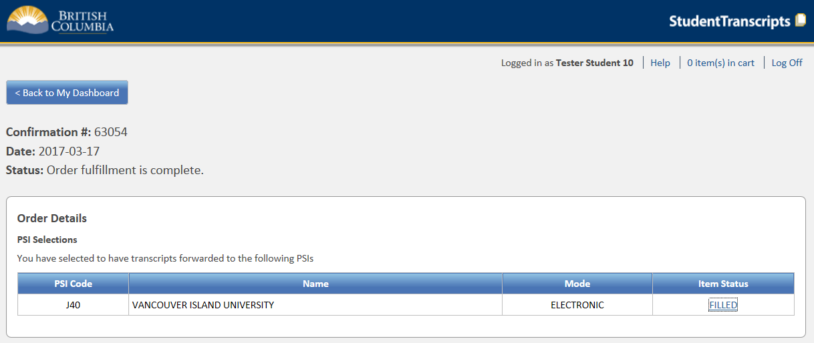
Review Order Details
Lists all of the institutions (Order Details) that constitute a particular Order
Some institutions (capable of receiving XML transcripts) will have a link on the Item Status to provide more information about when your transcript was sent and when it was received
Notes:
Once the order is complete, the student may view their order and see the status of each of the institutions selected on that order.
A “Filled” status that indicates that the transcript request has been placed
For PSIs able to receive the XML transcript, students may select the link on the Item Status to see more detailed dates and times that the transcript was sent and received by the PSI
For PSIs that receive printed transcripts, students can expect that it will take about 1 week for the PSI to receive the transcript via mail.
For PSIs that receive the electronic batch file, the student is recorded on the PSI selection file and the file of interim marks and final marks will be sent in May and July.

Slide 19
For more information
Ministry of Education
Student Certification Branch
Email: student.certification@gov.bc.ca

